Slide 1
Dimensionality Reduction
Marziyeh Mousavi
Introduction to datascience
Fall 2024

Slide 2
Content
Dimensionality reduction
Feature selection
Feature extraction
t_SNE

Slide 3
Dimensionality Reduction
Dimensionality reduction is the process of reducing the number of features (or dimensions) in a dataset while retaining as much information as possible. This can be done for a variety of reasons, such as to reduce the complexity of a model, to improve the performance of a learning algorithm, or to make it easier to visualize the data.

Slide 4
Dimensionality Reduction
There are several techniques for dimensionality reduction, including principal component analysis (PCA), singular value decomposition (SVD), and linear discriminant analysis (LDA). Each technique uses a different method to project the data onto a lower-dimensional space while preserving important information.

Slide 5
Feature Selection
Feature selection is the process of identifying and selecting relevant features that have important aspects that will boost the predictive power and accuracy of the model.

Slide 6
Feature selection
Filter Methods
1.Univariate Feature Selection
2.Correlation-based Feature Selection
3.Variance Thresholding
Wrapper methods
Embedded Methods

Slide 7

What is contingency table?
A contingency table displays frequencies for combinations of two categorical variables. Analysts also refer to contingency tables as crosstabulation and two-way tables.
In this contingency table, columns represent computer types and rows represent genders. Cell values are frequencies for each combination of gender and computer type. Totals are in the margins. Notice the grand total in the bottom-right margin.At a glance, it’s easy to see how two-way tables both organize your data and paint a picture of the results. You can easily see the frequencies for all possible subset combinations along with totals for males, females, PCs, and Macs.

Slide 8
Univariate feature selection
Univariate feature selection is a feature selection technique where the relationship between dependent variables and independent variables is evaluated. Independent variables with the strongest relationship with dependent variables are chosen
Univariate Feature Selection selects the most important features based on univariate statistical tests like chi-squared, Analysis of Variance (ANOVA), or mutual information.

Slide 9

Univariate feature selection using Chi-squared test
Let’s assume that we have three independent variables (X1, X2, and X3) and a dependent or target variable (Y) in our dataset. Using a chi-squared test, we want to find the most relevant feature. The chi-squared test method helps us determine the relationship between two categorical variables.
i is the independent variable
j is the dependent or target variable
Oij denotes the observed frequency in the contingency table.
Eij denotes the predicted frequency in the contingency table under the assumption of independent variable and dependent variable relationships.
The formula for chi-squared test

Slide 10
Univariate feature selection using Chi-squared test
let’s say the chi-squared values for our sample dataset are as follows:
x2(X1, Y)= 7.3
x2(X2, Y)= 6.8
x2(X3, Y)= 8.8
From the example above, if we were to choose the best feature, X3 would be the best because it has the highest score.

Slide 11
Implementation in python
BC_data = load_breast_cancer()
X, y = BC_data.data, BC_data.target
df = pd.DataFrame(X, columns=feature_names)
k_best_features = 10
selector = SelectKBest(score_func=chi2, k=k_best_features)
X_new = selector.fit_transform(X, y)
selected_indices = selector.get_support(indices=True)
selected_feature_names = BC_data.feature_names[selected_indices]

Slide 12
Correlation-based Feature Selection
Correlation-based Feature Selection is a technique that focuses on finding and selecting the most relevant features from a dataset. It accomplishes this by analyzing the relationship between each feature and the target variable. This technique identifies the most significant aspects that play a critical role in predicting the target variable by selecting features with strong correlations to the target.

Slide 13

Correlation-based Feature Selection
We calculate correlation using the Pearson correlation coefficient (r).
The r can be positive or negative, with r = +1 signifying a complete positive relationship. If r = -1, the correlation is totally negative, and r = 0 means there is no linear relationship.
Xi represents each data point of variable X.
Yi represents each data point of variable Y.
X represents the mean of variable X.
Y represents the mean of variable Y.

Slide 14
Implementation in Python
BC_data = load_breast_cancer()
X = pd.DataFrame(BC_data.data, columns=BC_data.feature_names)
y = BC_data.target
correlation_values = X.apply(lambda feature: np.abs(np.corrcoef(feature, y)[0, 1]))
sorted_features = correlation_values.sort_values(ascending=False)
k = 10
selected_features = sorted_features.index[:k]

Slide 15
Feature selection using variance threshholding
Variance thresholding is a feature selection technique that eliminates low-variance features from a dataset since they may not be relevant for prediction. These features are nearly constant, which means their values do not vary much and are less likely to contribute considerably to the model’s performance.’
We can choose an acceptable variance threshold to determine which features are kept and which are removed based on their variability between samples.

Slide 16
Implementation in python
BC_data = load_breast_cancer()
X = pd.DataFrame(BC_data.data, columns=BC_data.feature_names)
y = BC_data.target
variances = X.var()
threshold = 0.01
selector = VarianceThreshold(threshold=threshold)
X_selected = selector.fit_transform(X)
selected_features = X.columns[selector.get_support()]

Slide 17
Wrapper Methods
Wrapper methods are a type of feature selection technique that involves training a model iteratively with different subsets of features and evaluating their impact on the model’s performance.
We Explore REF method here.

Slide 18
Recursive Feature Elimination (RFE)
RFE is a simple yet effective feature selection strategy that is used to remove the least significant features from a model iteratively until the desired number of features is obtained. In this technique, the coefficients of each feature are calculated, and the feature with the lowest score is deleted.

Slide 19
RFE Example
Suppose that we have a data set with 4 features and our model in multiple linear regression
𝛽1 = 0.7 𝛽2 = 0.5 𝛽3 = 0.1 𝛽4 = -0.1
We delete the fourth feature because it has the least coefficient score.

Slide 20
Implementation in python
BC_data = load_breast_cancer()
X, y = data.data, data.target
X_train, X_test, y_train, y_test = train_test_split(X, y, test_size=0.2, random_state=42)
model = LogisticRegression(solver=’liblinear’, multi_class=’ovr’)
total_features = X_train.shape[1]
rfe = RFE(model, n_features_to_select=total_features)
# Fit the RFE to the training data
rfe.fit(X_train, y_train)
ranking = rfe.ranking_
num_irrelevant_features_eliminated = np.arange(total_features — 1, -1, -1)
accuracy_list = []
for i in num_irrelevant_features_eliminated:
rfe = RFE(model, n_features_to_select=(total_features — i))
rfe.fit(X_train, y_train)
y_pred = rfe.predict(X_test)
accuracy = accuracy_score(y_test, y_pred)
accuracy_list.append(accuracy)
#we choose the most accuracy

Slide 21
Embedded Methods
Embedded methods are a type of feature selection technique that includes feature selection as a vital aspect of the model training process.
Here we explore variable importance models.

Slide 22
Variable Importance Feature Selection (From Tree-Based Models)
Variance importance is a technique for determining the importance of each independent variable in predicting the target variable. Tree-based models, such as Decision Trees, Random Forests, and Gradient Boosting Machines, naturally give a measure of feature relevance based on their internal structure.

Slide 23
Variable Importance Feature Selection (From Tree-Based Models)
When a tree-based model is trained on a dataset, it makes decisions by segmenting the data based on unique attributes. The variables that are employed more frequently and result in considerable reductions in impurity or error are deemed more important.

Slide 24
Variable Importance Feature Selection (From Tree-Based Models)
There are several methods for calculating feature importance in tree-based models. Let’s explore each.
Gini feature importance: Gini feature importance calculates the total impurity reduction achieved by each feature across all decision nodes in a decision tree or across all trees in a random forest
Mean Gini feature importance: Calculates average impurity reduction achieved by each feature across all decision trees in the random forest

Slide 25
Variable Importance Feature Selection (From Tree-Based Models)
Permutation feature Importance: Measures the decline in model performance caused by randomly permuting the values of a feature while leaving other features unchanged. This technique is used in Gradient Boosting models.
Gain feature importance: Calculates the total improvement in the loss function achieved by each feature in the gradient boosting models' overall boosting rounds.

Slide 26
Implementation in python
BC_data = load_breast_cancer()
X, y = data.data, data.target
feature_names = BC_data.feature_names
df = pd.DataFrame(X, columns=feature_names)
# Create a Random Forest classifier
rf_classifier = RandomForestClassifier(n_estimators=100, random_state=42)
rf_classifier.fit(X, y)
# Get feature importances from the random forest
feature_importance = rf_classifier.feature_importances_
# Sort features by importance in descending order
sorted_indices = np.argsort(feature_importance)[::-1]
sorted_importance = feature_importance[sorted_indices]
sorted_feature_names = feature_names[sorted_indices]

Slide 27
Feature Extraction
Feature extraction is the process of selecting and transforming raw data into a more useful and meaningful representation that can be used for analysis, modeling, or decision-making. The goal of feature extraction is to identify the most relevant and important information in the data, while discarding irrelevant or redundant information.

Slide 28
Feature Extraction Different Domains
Image Processing: Techniques like edge detection filters, Gabor filters, and Histogram of Oriented Gradients (HOG) can be used to extract features from images.
Text Data: Natural Language Processing uses techniques such as Bag of Words, TF-IDF, and word embeddings to extract features from text.
Audio Processing: Features like Mel-frequency cepstral coefficients (MFCCs) and spectral contrast are used in audio signal processing.

Slide 29
Feature Extraction Techniques
Principal Component Analysis

Slide 30
PCA (Principal Component Analysis )
Principal Component Analysis is a statistical process that converts the observations of correlated features into a set of linearly uncorrelated features with the help of orthogonal transformation. These new transformed features are called the Principal Components. It is one of the popular tools that is used for exploratory data analysis and predictive modeling.
PCA works by considering the variance of each attribute because the high attribute shows the good split between the classes, and hence it reduces the dimensionality. Some real-world applications of PCA are image processing, movie recommendation system, optimizing the power allocation in various communication channels.

Slide 31




PCA step by step algorithm
Step 1: Standardization
First, we need to standardize our dataset to ensure that each variable has a mean of 0 and a standard deviation of 1.
is the mean of the independent features
is the standard deviation of the independent features
X_mean = X.mean()
# Standard deviation
X_std = X.std()
# Standardization
Z = (X - X_mean) / X_std

Slide 32

PCA step by step algorithm
Step2: Covariance Matrix Computation
Covariance measures the strength of joint variability between two or more variables, indicating how much they change in relation to each other. To find the covariance we can use the formula:
The value of covariance can be positive, negative, or zeros.
Positive: As the x1 increases x2 also increases.
Negative: As the x1 increases x2 also decreases.
Zeros: No direct relation
c = Z.cov()

Slide 33
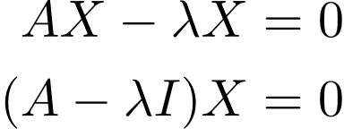


PCA step by step algorithm
Step 3: Compute Eigenvalues and Eigenvectors of Covariance Matrix to Identify Principal Components
Let A be a square n*n matrix and X be a non-zero vector for which
where I am the identity matrix of the same shape as matrix A. And the above conditions will be true only if will be non-invertible (i.e. singular matrix). That means,
eigenvalues, eigenvectors = np.linalg.eig(c)

Slide 34
PCA step by step algorithm
Step 4: we calculate the explained variance and select the components with most variance.
# Index the eigenvalues in descending order
idx = eigenvalues.argsort()[::-1]
# Sort the eigenvalues in descending order
eigenvalues = eigenvalues[idx]
# sort the corresponding eigenvectors accordingly
eigenvectors = eigenvectors[:,idx]
explained_var =np.cumsum(eigenvalues)/np.sum(eigenvalues)
n_components = np.argmax(explained_var >= 0.50) + 1
u = eigenvectors[:,:n_components]

Slide 35
Implementation in Python
# Importing PCA
from sklearn.decomposition import PCA
# Let's say, components = 2
pca = PCA(n_components=2)
pca.fit(Z)
x_pca = pca.transform(Z)
# Create the dataframe
df_pca1 = pd.DataFrame(x_pca, columns=['PC{}'.format(i+1) for i in range(n_components)])

Slide 36
t-SNE(t-distributed stochastic neighbor embedding)-t-distribution
let’s talk about t-distribution.
As we know normal distribution assumes two important characteristics about the dataset: a large sample size and knowledge of the population standard deviation. However, if we do not meet these two criteria, and we have a small sample size or an unknown population standard deviation, then we use the t-distribution.

Slide 37
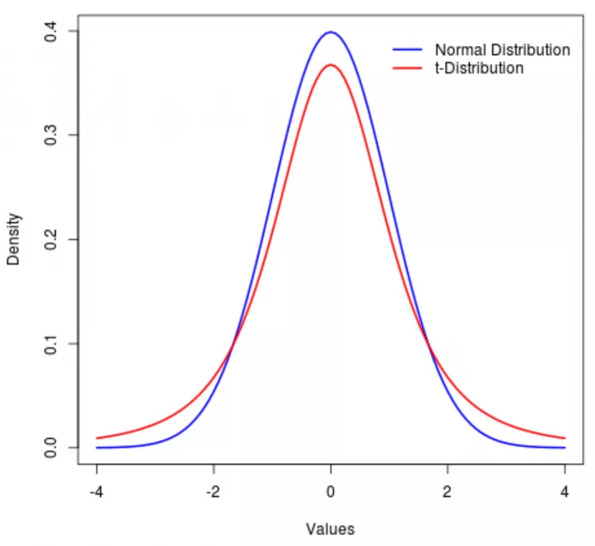
t-SNE(t-distributed stochastic neighbor embedding)
Student’s t-distribution, also known as the t-distribution, is a probability distribution that is used in statistics for making inferences about the population mean when the sample size is small or when the population standard deviation is unknown. It is similar to the standard normal distribution (Z-distribution), but it has heavier tails.

Slide 38
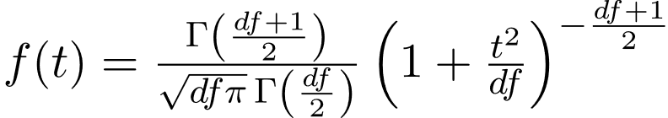
t-SNE(t-distributed stochastic neighbor embedding)-t-distribution
Γ(.) is the gamma function
df= Degrees of freedom
Formula of t-distribution
Unlike the z-score, which employs the population standard deviation, the t-score uses the estimated standard deviation from the sample. This results in a t-distribution with (n – 1) degrees of freedom, emphasizing the t-distribution’s role in handling uncertainty when estimating the population standard deviation, especially in small sample sizes.

Slide 39
t-SNE(t-distributed stochastic neighbor embedding)
The core idea behind t-SNE is to map high-dimensional data points to a lower-dimensional space, typically two or three dimensions, in a way that preserves the local relationships between points. It achieves this by measuring the similarity between data points in the high-dimensional space and representing this similarity as probabilities.

Slide 40
t-SNE(t-distributed stochastic neighbor embedding)-Measuring Similarity
Stage-1
One approach is to compute the distance between points, but this method becomes less reliable in higher dimensions due to the “curse of dimensionality.” Instead of relying solely on distance calculations, t-SNE utilizes a probabilistic approach. For each data point, such as x1, a Gaussian distribution is plotted around it with a mean of zero, and the standard deviation is determined based on the density of nearby points around x1.

Slide 41
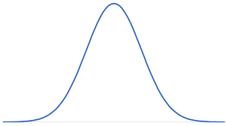
t-SNE(t-distributed stochastic neighbor embedding)-Measuring Similarity
Now, on the x-axis, we consider distances from a reference point, such as x1. For each point in the dataset, we calculate its distance to x1 and plot these distances along the x-axis. The y-axis represents the corresponding probability density, allowing us to determine the probability of each data point relative to x1, which serves as the similarity score for that point.
X1
X2

Slide 42
t-SNE(t-distributed stochastic neighbor embedding)-Measuring Similarity
Stage-3
To preserve the local relationships between points, ensuring that neighboring points remain close in the lower dimension, we aim to align the lower-dimensional matrix with the higher-dimensional one. This alignment involves adjusting the position of points iteratively until the similarity matrix in the lower dimension resembles the one in the higher dimension as closely as possible.

Slide 43
t-SNE(t-distributed stochastic neighbor embedding)-Mathematical Formulation
Computing Similarities:
For each data point in the high-dimensional space, we calculate its similarity to every other point using a Gaussian distribution. This similarity is based on the distance between points.
Similarly, in the low-dimensional space, we calculate similarities between points using a t-distribution.

Slide 44
t-SNE(t-distributed stochastic neighbor embedding)-Mathematical Formulation
Objective Function:
We want to minimize the difference between the similarities of points in the high-dimensional space and their counterparts in the low-dimensional space. We measure this difference using the Kullback-Leibler (KL) divergence.
The KL divergence measures how one probability distribution diverges from another. In our case, it quantifies how different the pairwise similarities are between the high-dimensional and low-dimensional spaces.

Slide 45
t-SNE(t-distributed stochastic neighbor embedding)-Mathematical Formulation
Gradient Descent:
To minimize the KL divergence, we use gradient descent. This iterative optimization technique adjusts the positions of points in the low-dimensional space.
At each iteration, we compute the gradient of the cost function with respect to the positions of the points in the low-dimensional space.This gradient indicates the direction in which we should move each point to reduce the difference between the high-dimensional and low-dimensional similarities.

Slide 46
Implementation in python
mnist = fetch_openml('mnist_784', version=1)
X = mnist.data / 255.0
y = mnist.target
tsne = TSNE(n_components=2, perplexity=30, n_iter=1000, random_state=42)
X_tsne = tsne.fit_transform(X)

